Slide 1

Car Rental
ACS560 Project
Winnie Har, Bibin Prakash, Sanidhya Sharma

Slide 2
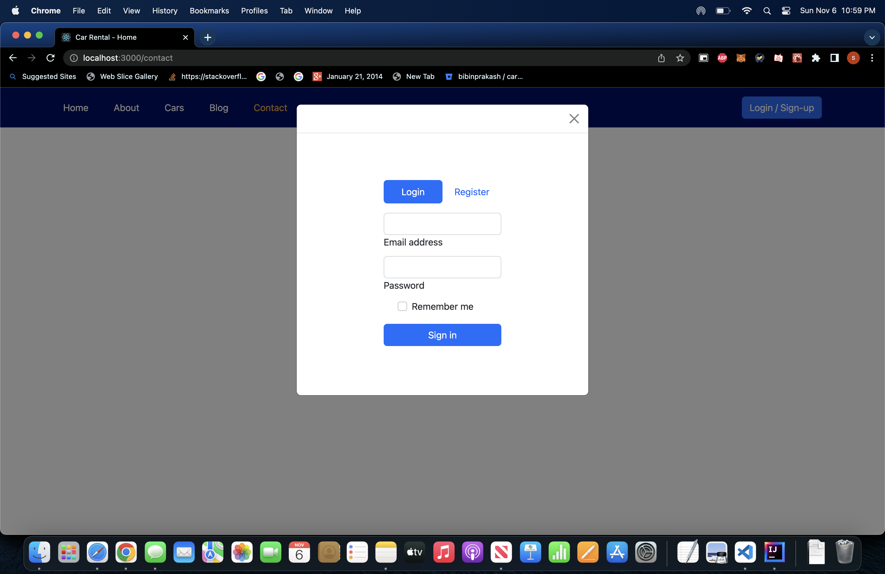
Login/Sign Up

Slide 3
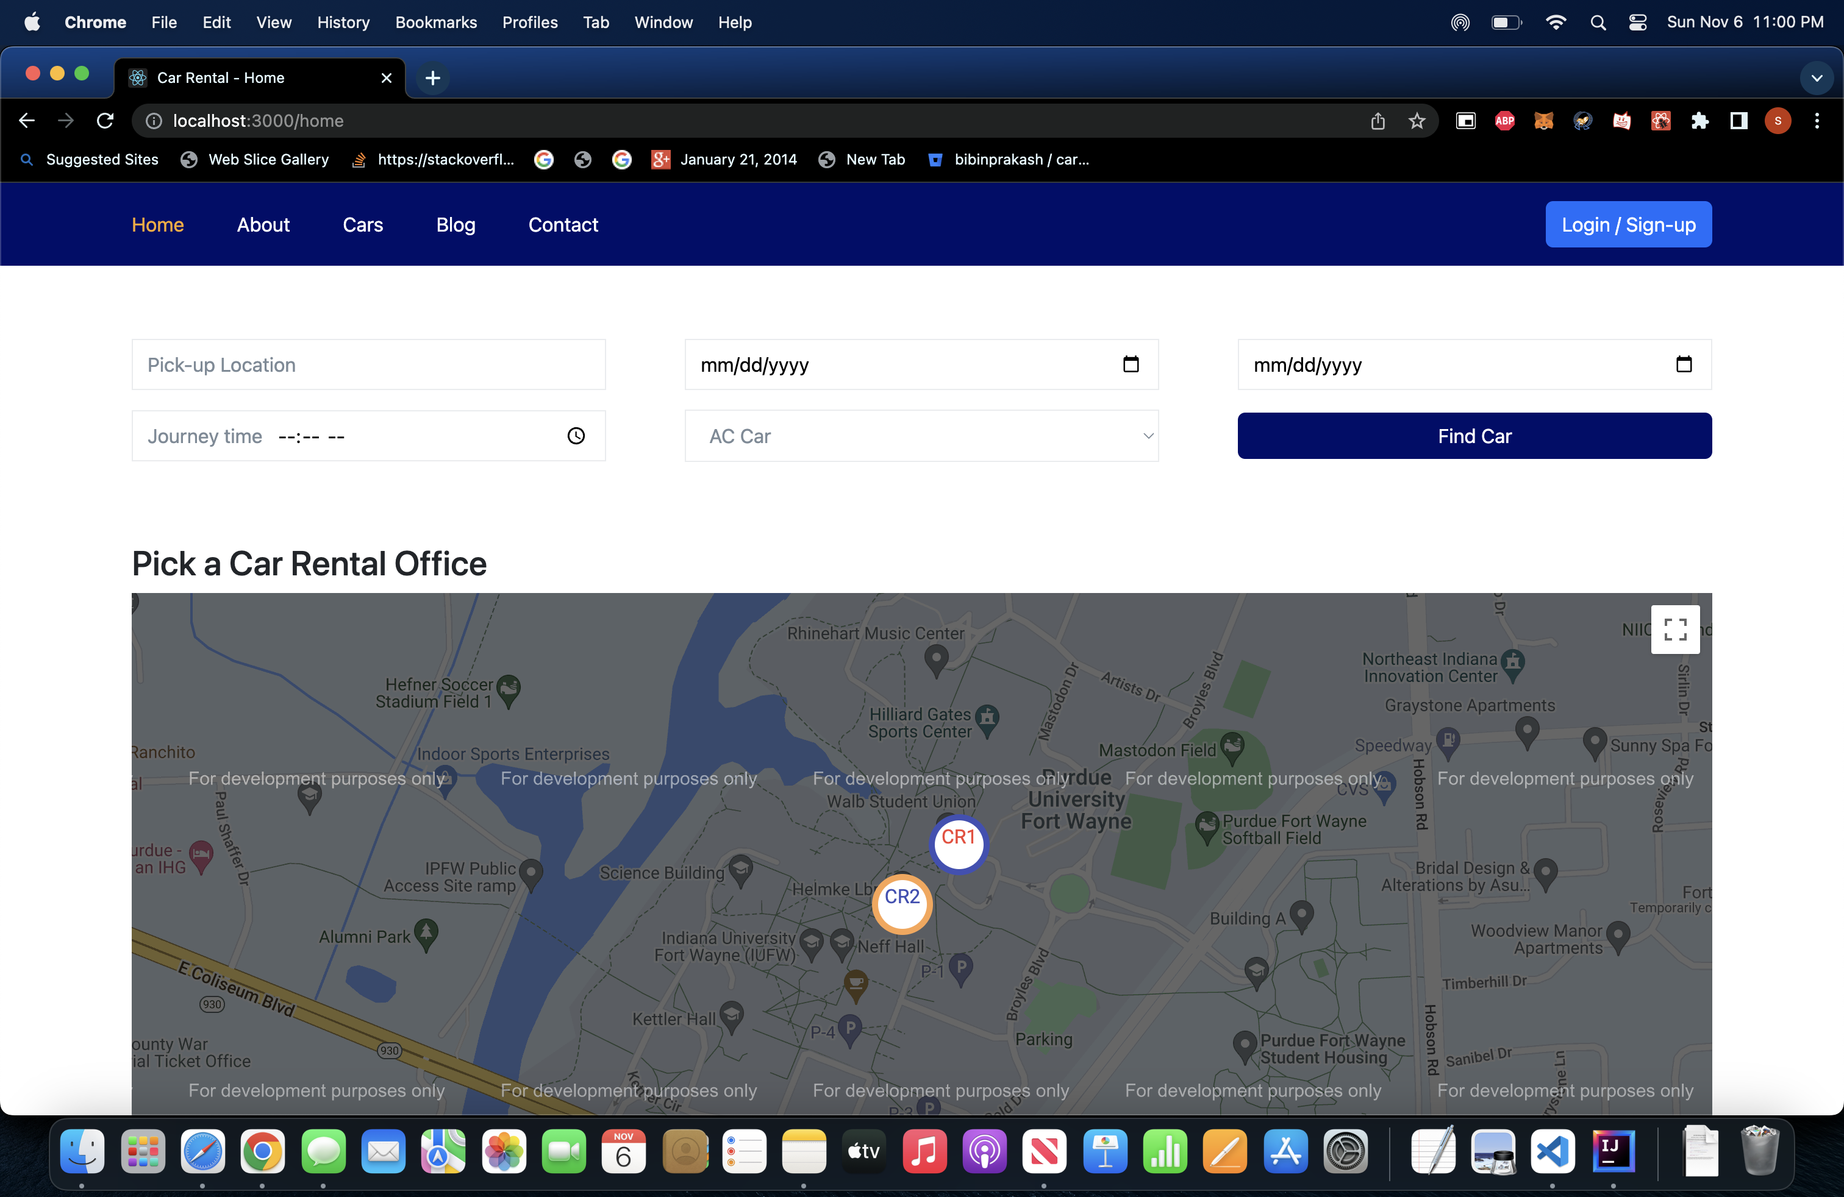
Home Page

Slide 4
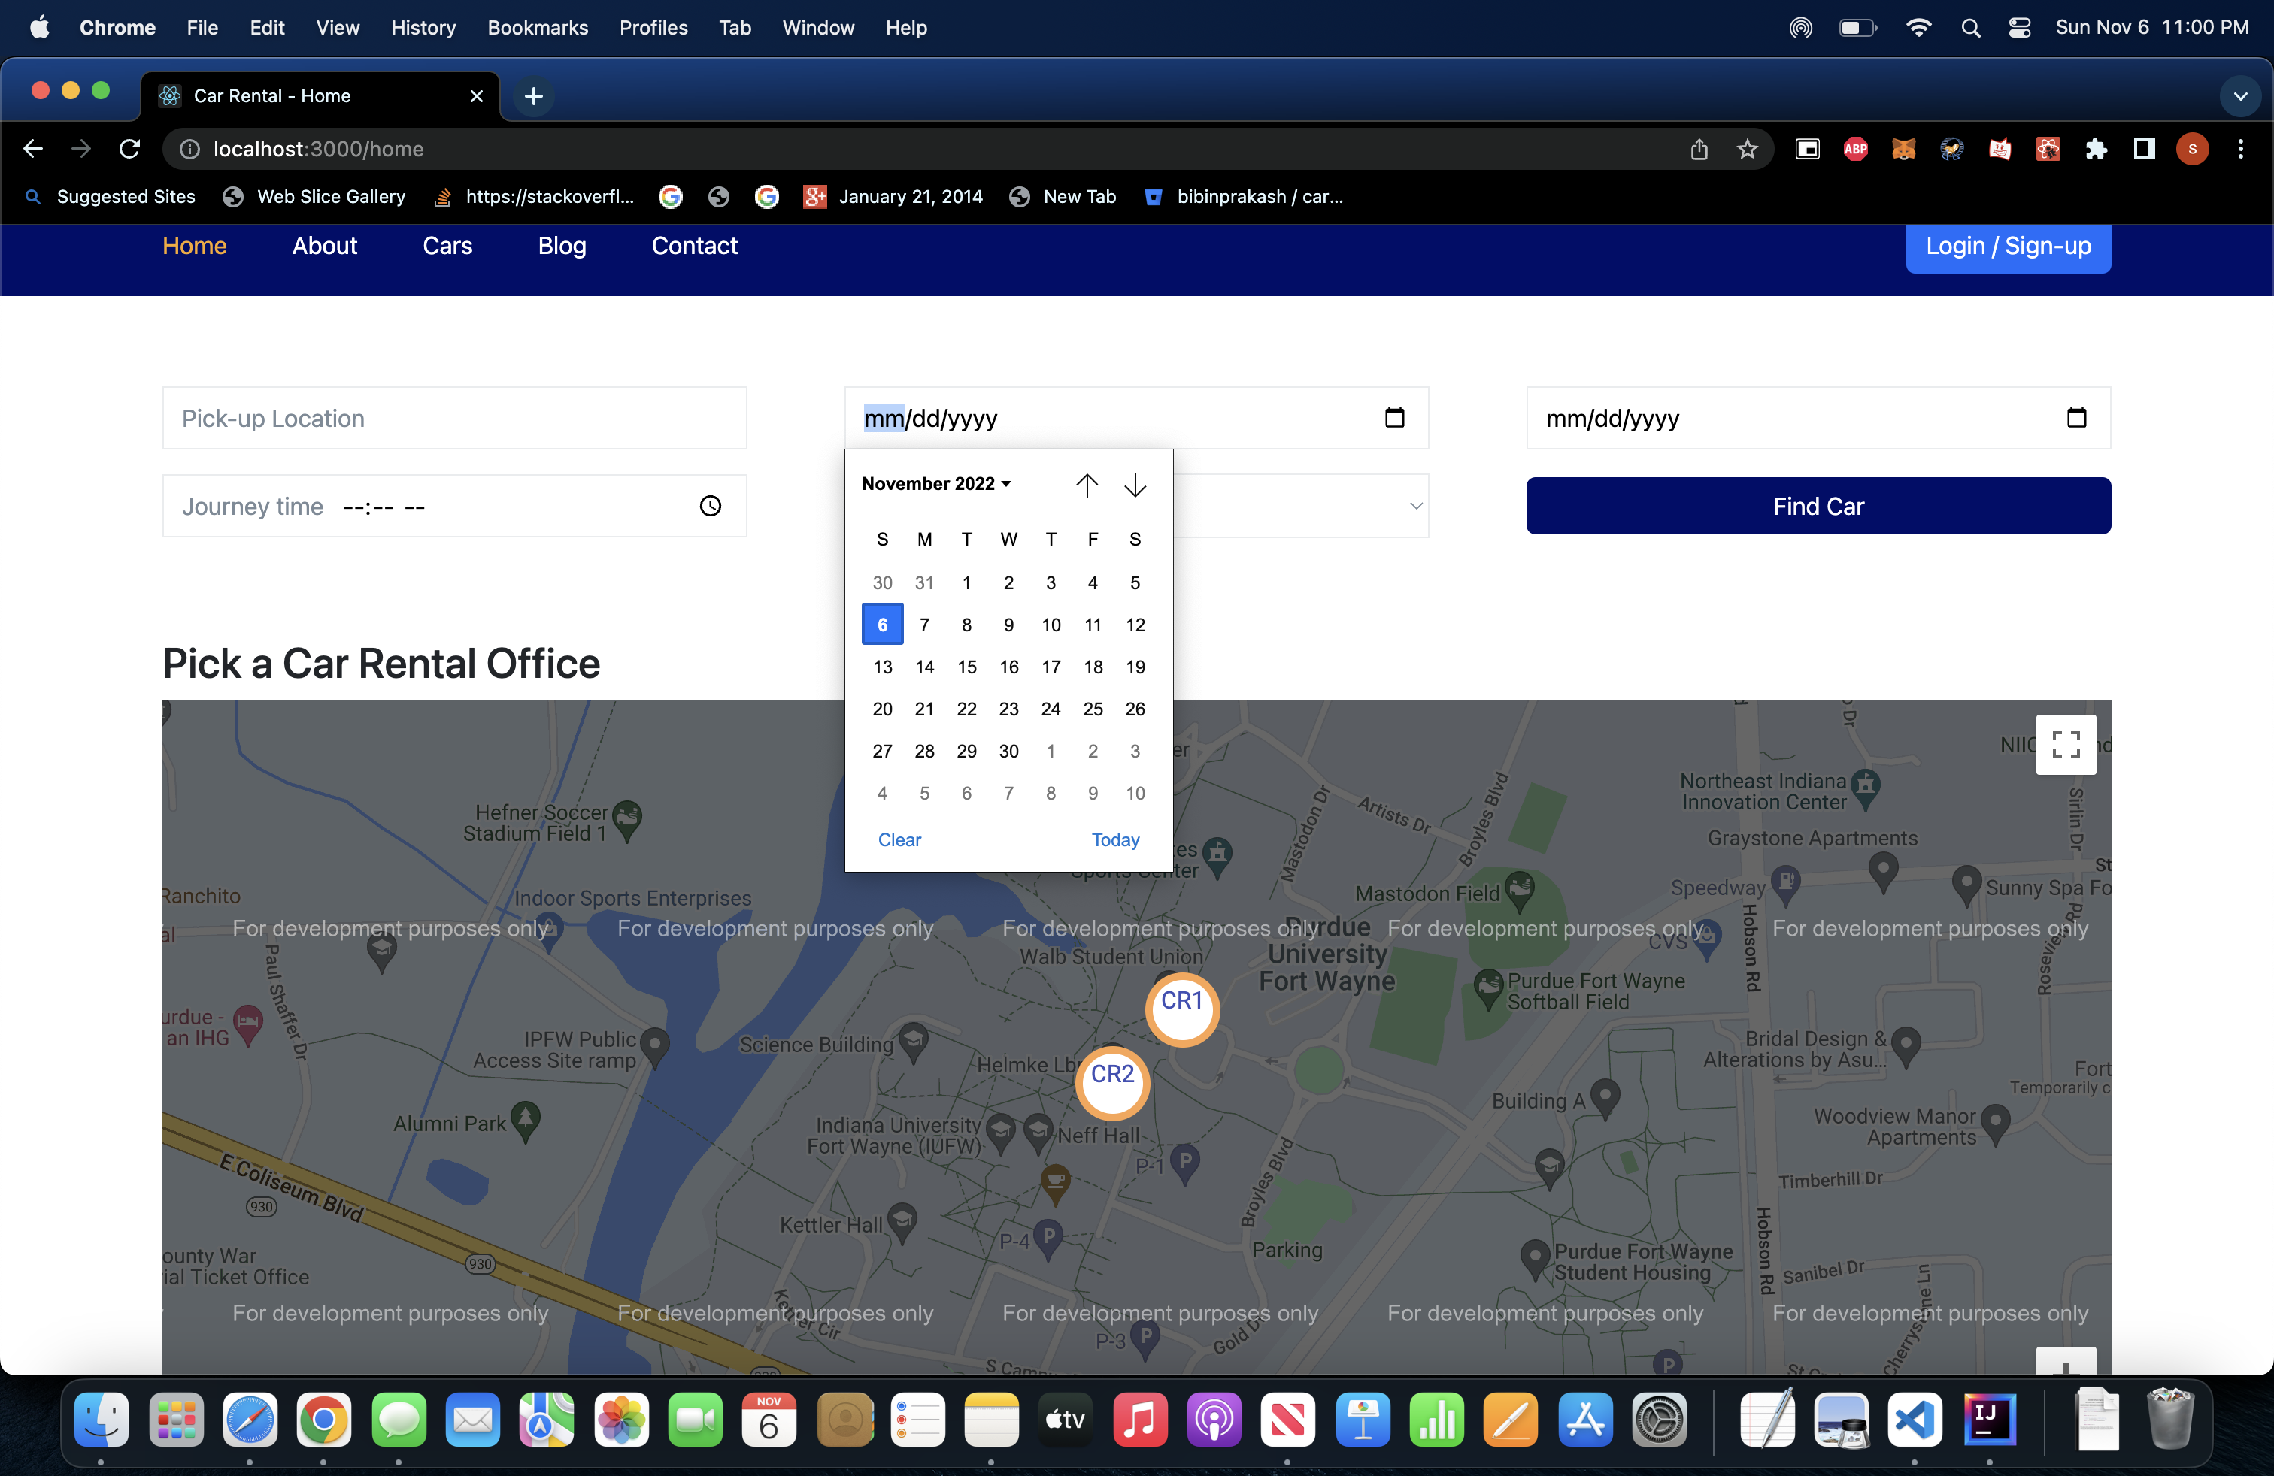
Date Picker

Slide 5
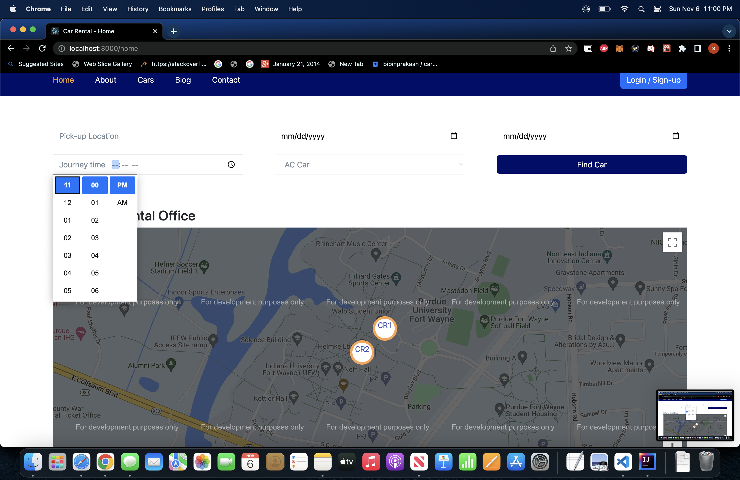
Time picker

Slide 6
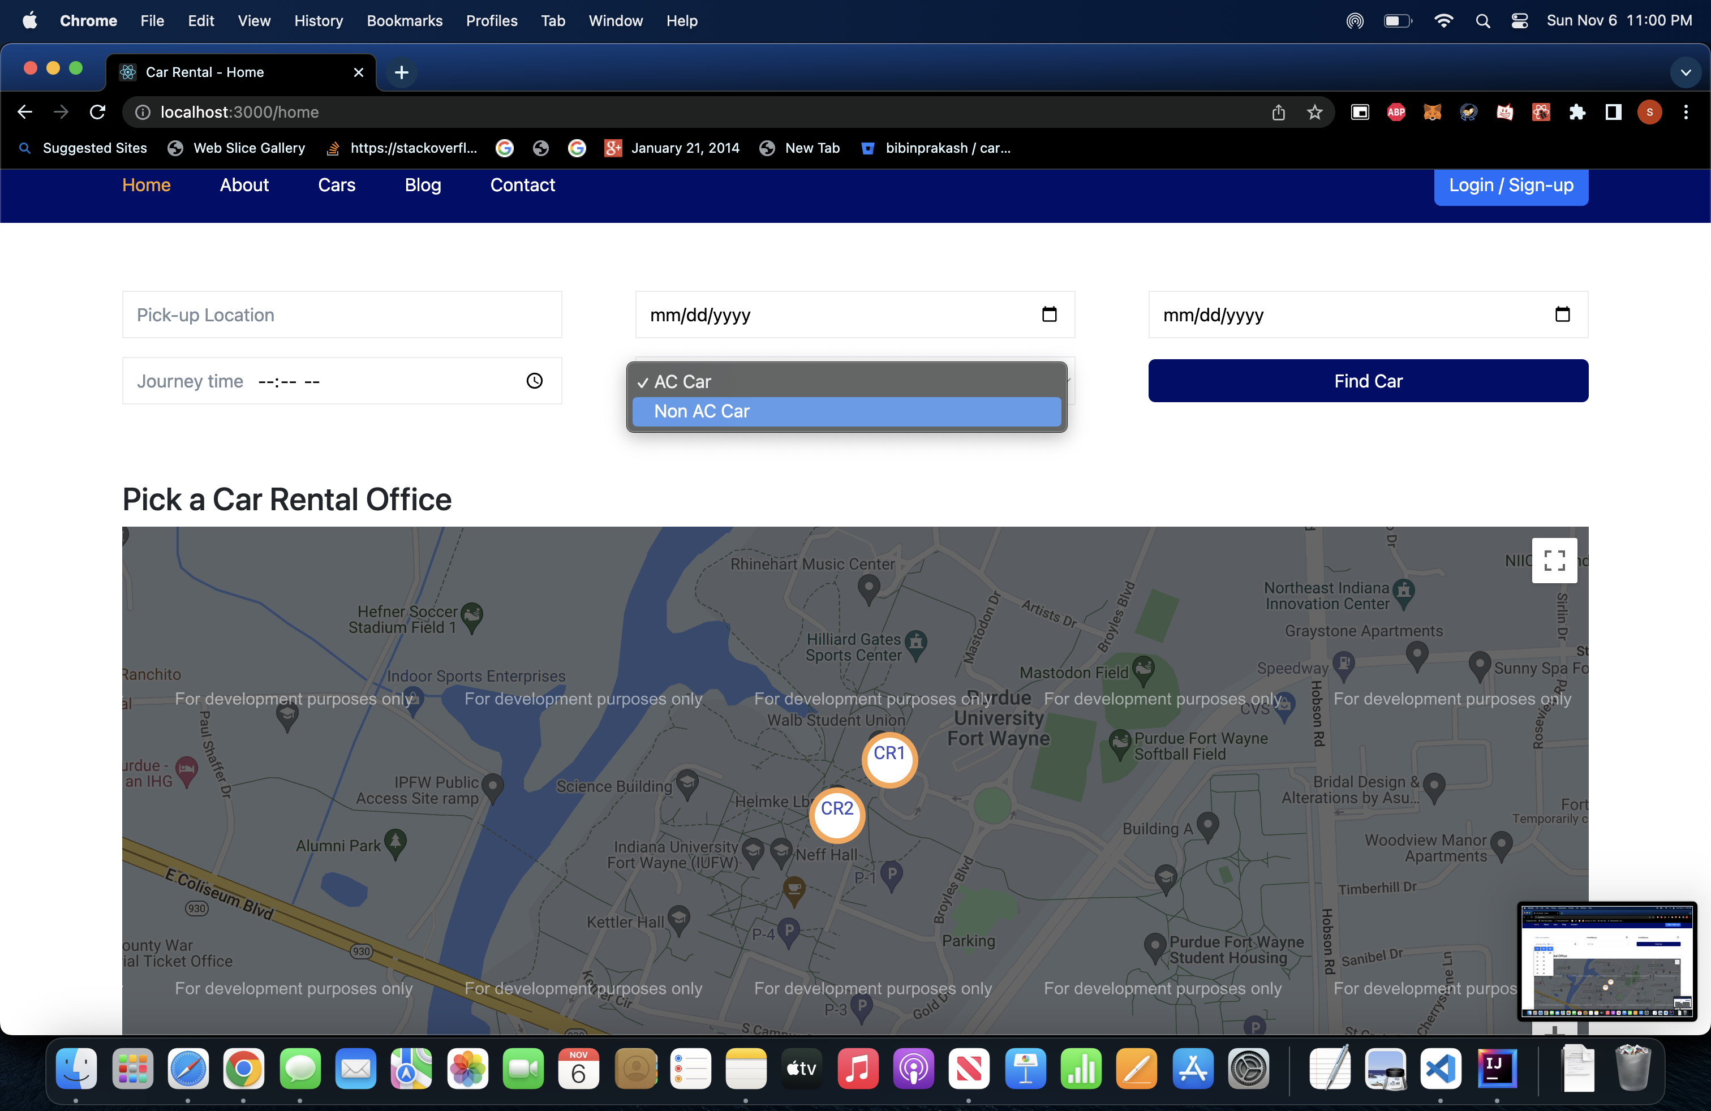
Type of car selector

